Slide 1
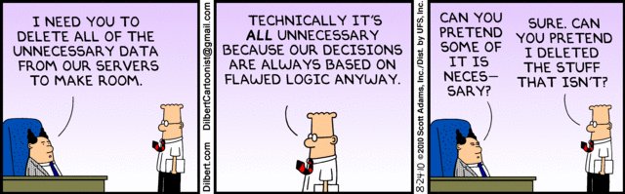
Program Design and Construction
Java and Database
Quan Bai

Slide 2
Overview
A brief review of database
Overview of JDBC
Steps to Use JDBC
Using Apache Derby (Java DB)

Slide 3
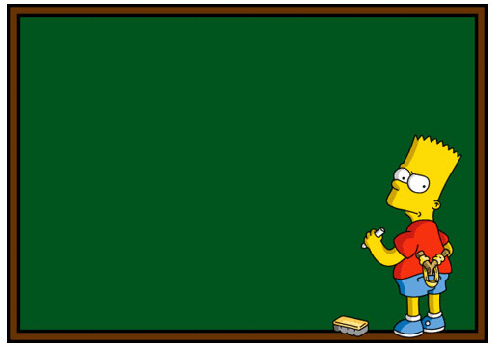
A brief review of Database
Database (DB):
  an organised collection of data
Relational DBs (first published by Edgar F. Codd (IBM) in 1970) store data in:
  tables
A table in a database consists of:
  rows & columns
  Rows: records
  Columns: attributes of the records
SQL:
  Structured Query Language,
  The industry standard database query language (relational Database)

Slide 4
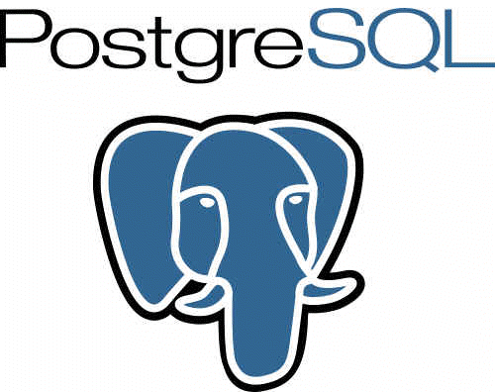


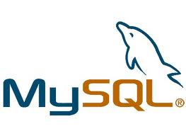

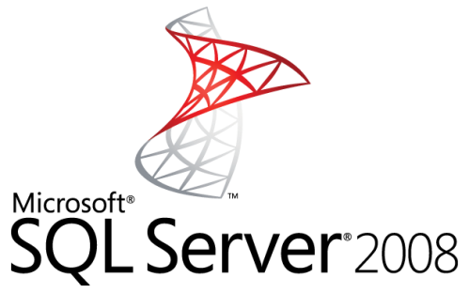
A brief review of Database (cont.)
DB Management System (DBMS):
  a set of software programs that controls the organization, storage, management, and retrieval of data in a database.
Popular RDBMSs:

Slide 5
A brief review of Database (cont.)
SELECT NAME, ID FROM STUDENT WHERE GENDER=‘MALE’;
INSERT INTO STUDENT VALUES ( 6, ‘MARY’,
‘FEMALE’ );
DELETE FROM STUDENT WHERE NAME=‘JERRY’;
DROP TABLE STUDENT;

Slide 6

Why JDBC?
API for ORACLE
JDBC
(Java)
ODBC
(MS)
API for MySQL
Applications
(C, C++, JAVA, …)
API for
SQL Server
API for …
…

Slide 7
Overview of JDBC
JDBC makes it possible to:
  Establish a connection with a database
  Send SQL statements to a database
  Process the results

Slide 8
Overview of JDBC (cont.)
Java DataBase Connectivity: java.sql
Major components in JDBC:
  JDBC API gives access of programming data from the Java. By using JDBC API, applications can execute SQL statements and retrieve results and updation to the database. It standardise:
    Way to establish connection to database
    Approach to initiating queries
    The data structure of query result
    It does NOT standardise SQL syntax
  JDBC Driver Manager is the class in JDBC API. The objects of this class can connect Java applications to a JDBC driver

Slide 9
How to use JDBC
Establishing a connection to DB
Create a Statement instance to conduct SQL statements
Execute queries from JDBC
Receive, hold and process query results from DB
Check meta-information of results & databases

Slide 10
1. Establish a connection
Creates instance of a Connection object
Connection conn = DriverManager.getConnection(
“url”, “username”, “password”); [throws SQLException]
return Connection object: Creates a Statement object for sending SQL statements to the database.
DB host address
Username, Password
  String url= "jdbc:derby: // localhost:1527/ CarDB; create=true";
Driver type (which type of DBMS to connect)
The driver of the DBMS needs to be included in the library of the Java project
Whether you want to auto connect/create
Where you want to store the DB
Name of the DB

Slide 11
DB URL:
  localhost:XXXX: the default DB directory of your DBMS.
  E.g.:
  No DB directory specified: the directory of the Java project, i.e., the project directory
  E.g.:
  String url= "jdbc:derby: // localhost:1527/ CarDB; create=true";
The default DB directory of Derby JavaDB
Can be setup in JavaDB, or Java IDE (e.g., in NetBeans, under “services-> JavaDB -> “property””)
String url = "jdbc:derby:CarDB; create=true";

Slide 12
Establish a connection (cont.)
Example 1: Connect a DB
We have a MySQL DB called cartdb
Write a Java program to connect cardb
cartable
ID | Brand | Model | Price
1 | Toyota | Camry | 18000
2 | Toyota | Corolla | 9800
3 | Nissan | Pulsar | 6800
 | … | … | …

Slide 13
public static Connection conn;
public static String url="url="jdbc:mysql://localhost/CarDB";
public static String username="root";
public static String password="010101";
public void establishMySQLConnection()
{
try{
conn=DriverManager.getConnection(url, username, password);
System.out.println(url+" connected...");
}
catch (SQLException ex) {
System.err.println("SQLException: " + ex.getMessage());
}
}

Slide 14
Statement
Statement: object that can accept and execute a string that is a SQL statement
Executing statements:
  executeUpdate: for database modifications
  executeQuery: for database queries
  Execute DB update statement:
Statement statement = conn.createStatement();
statement.executeXXXXX("a SQL statement");
SQL query statement
statement.executeUpdate(“CREATE TABLE CARTABLE”);

Slide 15
Batch
statement.executeUpdate(“statement 1");
Statements will be sent to DBMS and executed individually
addBatch() and executeBatch() can allow us to execute multiple statements at one time
statement.executeUpdate(“statement 2“);
…
statement.executeUpdate(“statement n");
statement.addBatch (“statement 1");
statement.addBatch(“statement 2“);
…
statement.addBatch(“statement n");
statement.executeBatch();

Slide 16
Example 2: Create a table in JDBC
Use JDBC to:
  Check whether there is a table called cartable in cardb, delete it if it exists
  Create a table called car in carcb in JDBC
car
ID (p) | Brand | Model | Price
1 | Toyota | Camry | 18000
2 | Toyota | Corolla | 9800
3 | Nissan | Pulsar | 6800
 | … | … | …

Slide 17
public void createTable()
{
try{
Statement statement=conn.createStatement();
String newTable="cartable";
statement.executeUpdate("drop table if exists "+newTable);
String sqlCreateTable="CREATE TABLE "+newTable+" (ID INT, "
+ "MAKE VARCHAR(50), MODEL VARCHAR(50), PRICE INT )";
statement.executeUpdate(sqlCreateTable);
}
catch (SQLException ex) {
System.err.println("SQLException: " + ex.getMessage());
}
}

Slide 18
Query Statement
VARCHAR() INT
    Execute DB Query statement:
ResultSet: an object of type ResultSet is like a cursor
  next() advances cursor to next tuple:
  The first time next() returns the first tuple
  If no more tuples then next() returns FALSE
  Accessing components of a tuple:
    getXXX(attribute name OR column index)
 | A1 | A2
Row 1 | Value | Value
Row 2 | Value | Value
… | … | …
Row n | Value | Value
false
ResultSet rs=Statement.executeQuery(“SELECT * FROM CAR”);
while (rs.next())
{
String attribute1= rs.getString(“A1”);
int attribute2= rs.getInt (2);
}
A1 is VARCHAR()
A2 is INT

Slide 19
Query Statement (cont.)
More methods control the cursor:
  previous(): moves the cursor backwards one row. Returns true if the cursor is now positioned on a row and false if the cursor is positioned before the first row.
  first()/last(): moves the cursor to the first/last row
  afterLast(): moves the cursor to the end of this ResultSet object, just after the last row
  beforeFirst(): moves the cursor to the front of this ResultSet object, just before the first row

Slide 20
Example 3: Query a table in JDBC
Get the Model and Price of all Toyota cars in Car
Print the query results
Car
ID (p) | Brand | Model | Price
1 | Toyota | Camry | 15000
2 | Toyota | Corolla | 9800
3 | Nissan | Pulsar | 6800
 | … | … | …

Slide 21
public ResultSet getQuery()
{
ResultSet rs=null;
try {
Statement statement=mysqlConn.createStatement();
String sqlQuery="select model, price from car "
+ "where brand='toyota'“;
rs=statement.executeQuery(sqlQuery);
while( rs.next() )
{
String model= rs.getString ("model"); // String model= rs.getString (1);
int price = rs.getInt(2);
System.out.println(model+": $"+price);
}
System.out.println("Table created");
} catch (SQLException ex) {
Logger.getLogger(DBOperations.class.getName()).log(Level.SEVERE, null, ex);
}
return(rs);
}

Slide 22
Metadata
Database product name : Apache Derby
Database version: 10.5.3.0 - (802917)
URL: jdbc:derby://localhost:1527/CarDB
driver name: Apache Derby Network Client JDBC Driver
driver version: 10.5.3.0 - (802917)
Metadata:
  “Data of data”
  A description about a data or data the containers of data. E.g., a webpage may include metadata specifying what language it's written in, what tools were used to create it, ....
DB meta data: information about a database, e.g., the capabilities, the vendor, etc
  DatabaseMetaData: object that can hold DB metadata
  getXXXX() methods to obtain DB information, e.g., vendor name, url, driver name,…
DatabaseMetaData dbmd = conn.getMetaData(); ;
System.out.println ("Database product name : " + dbmd.getDatabaseProductName()); System.out.println ("Database version : " + dbmd.getDatabaseVersion());
System.out.println("URL: "+ dbmd.getURL());
System.out.println("driver name: "+ dbmd.getDriverName());
System.out.println("driver version: "+ dbmd.getDriverVersion());

Slide 23
Metadata (cont.)
ResultSet metadata:
  ResultSetMetaData: objects that can hold ResultSet metadata
  ResultSetMetaData rsmd = rs.getMetaData();
  To get number of columns:
  rsmd.getColumnCount();
  To get the table name of a given column in the result set:
  rsmd.getTableName( int );
  To get data type of a given column:
  rsmd.getColumnType( int );
Column index number

Slide 24
Closing
Statement statement = conn.createStatement();
ResultSet rs = statement.executeQuery();
Close ResultSet:
rs.close( );
Close Statement:
statement.close( );
Close Connection:
conn.close( );
A statement will be closed if the connection instance it belongs to is closed;
A resultset will be closed if the statement instance it holds results for is closed.

Slide 25
Apache Derby (Java DB)
Apache Derby: is an open source relational database implemented entirely in Java
Some advantages of Apache Derby:
  Derby has a small footprint -- about 2.6 megabytes for the base engine and embedded JDBC driver
  Derby is based on the Java, JDBC, and SQL standards
  Derby provides an embedded JDBC driver that lets you embed Derby in any Java-based solution
Environment: Derby requires Java 2 Standard Edition (J2SE) 1.4.2 or higher
Download at: http://db.apache.org/derby/derby_downloads.html

Slide 26
Apache Derby (Java DB)
Setup your JavaDB:
  Driver location
  Setup everything from your Java program?
    String url= "jdbc:derby: // localhost:1527/ CarDB; create=true";
  DB location

Slide 27
Questions??

